Slide 1
Dota 2 Match Prediction
- Final Project -
Introduction: 0745062 Aida Gasanova
Data Mining: 0745061 Ivan Kakhaev
Data Modeling: 0745087 Robin Mike Wiethuchter
Machine Learning: 0745102 Mikael Paavola
Notes:
For our final project we chose to use data from the video game Dota2. Our idea is to use data about matches and players to predict who wins the game. But before we get into the data and code I will give you a short introduction about the game

Slide 2
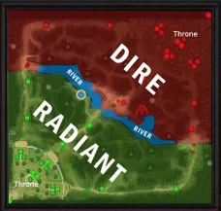
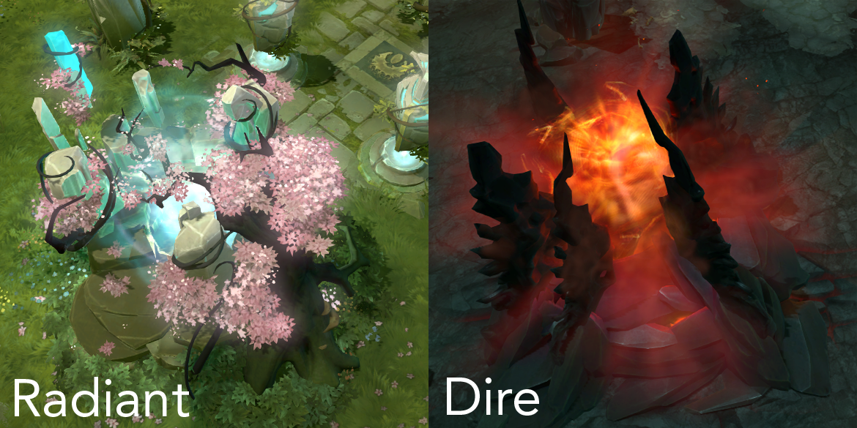
Introduction
Dota 2. Game overview
Ten players (5 versus 5)
Two teams: Radiant and Dire
One player controls one hero
Notes:
Dota 2 is played with 10 players and pits 5 players on one side versus 5 on the other. The 2 sides are named 'Radiant' and 'Dire’. Each team starts on opposite corners of the map. Each player controls one hero for the length of the match.
The ultimate object of any game of Dota 2 is to destroy the 'Throne' of the opposing team. This is the last building, and situated the deepest in each base.

Slide 3
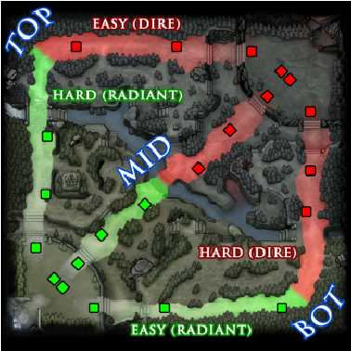
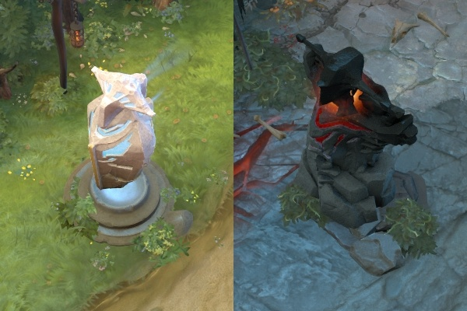
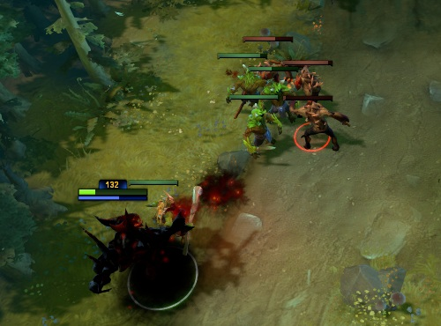
Introduction
Map
Towers
Three lanes: top, mid, bot
Each lane: 6 towers (3 for each team)
Creeps
Notes:
The map is broken up into 3 lanes.
Each lane is lined with 6 towers (3 for each team) that will attack enemy players or units that approach.
Each base has two structures for each lane that spawns 'creeps' or monsters at regular intervals to send to attack the enemy structures.

Slide 4
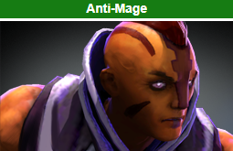
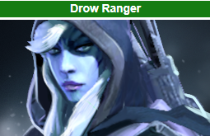


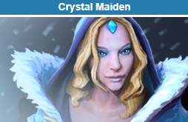

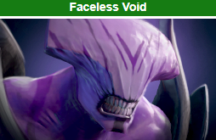
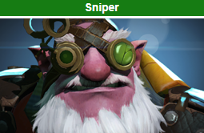
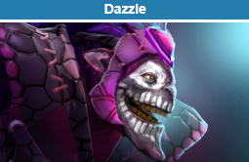
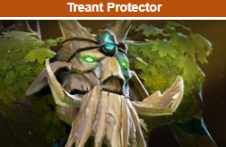
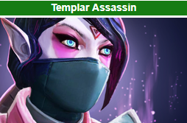
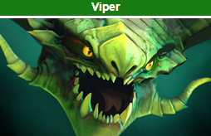
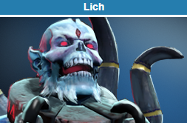
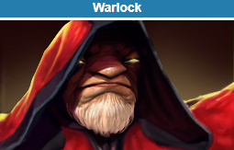
Introduction
Carries
Carries begin each match as weak and vulnerable, but are able to become more powerful later in the game, thus becoming able to "carry" their team to victory.
Supports
Supports generally lack abilities that deal heavy damage, instead having ones with more functionality and utility that provide assistance for their carries, such as providing healing and other buffs.
Carry Support Nuker Disabler Jungler Durable Escape Pusher Initiator
Notes:
Ten players each control one of the game's 116 heroes. Heroes are divided into roles, as you see at the bottom of the slide
For example "carry" will become more useful later in the game if they gain a significant gold advantage and "supports" to support the team.

Slide 5
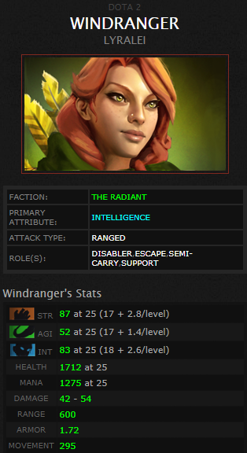
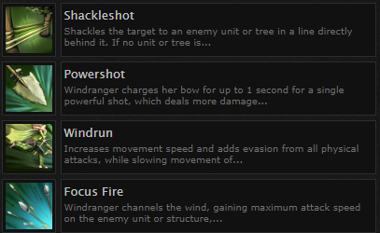
Introducton
Heroes
Abilities
Attributes: strength, intelligence, agility
Health points
Mana points
Attack speed
Notes:
Each hero has at least four unique abilities. All heroes have three attributes: strength, intelligence, and agility, which affect health points, mana points, and attack speed, respectively.

Slide 6
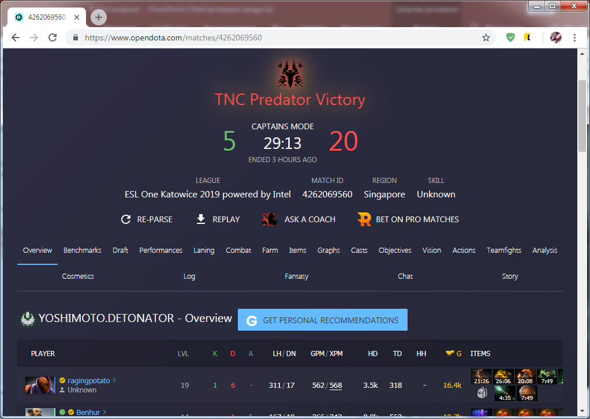
Introduction
Notes:
We collect information from open source Dota 2 data platform about matches, players and heroes. Objective: to predict who will win, using data about heroes and players

Slide 7
2. Data Mining
0745061 Ivan Kakhaev

Slide 8
Data mining
Match INFO
Player INFO
opendota.api
dotabuff.com
getMatchesList.py
matchID.json
(matchInfo list)
getPlayersID
fromMatch.py
getPlayersInfo.py
(web scraper)
matchesList.json
(matchesID list)
getMatchInfo.py
players.id
(playersID list)
playerID.json
(playerInfo list)
Notes:
So how we collected information. All information was divided into two large groups: information about matches and information about players
---
Итак каким образом мы собирали информацию. Информация разделилась на две больших группы: информация о матчах и информация о игроках.

Slide 9
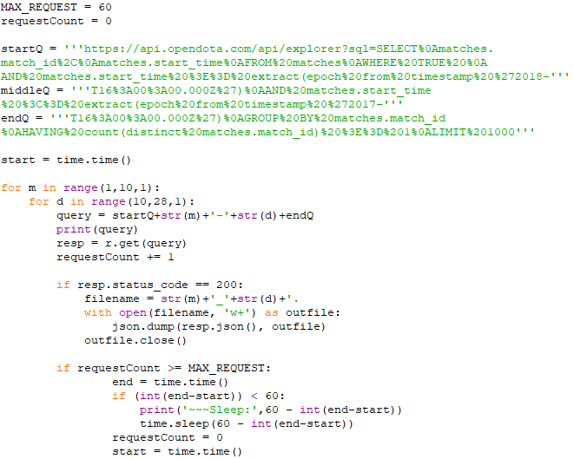
Data mining
Match INFO
Player INFO
opendota.api
dotabuff.com
getMatchesList.py
matchID.json
(matchInfo list)
getPlayersID
fromMatch.py
getPlayersInfo.py
(web scraper)
matchesList.json
(matchesID list)
getMatchInfo.py
players.id
(playersID list)
playerID.json
(playerInfo list)
Notes:
The beginning of the collection of information starts with the list of matches played. We send SQL request to opendota.api with period of time we want to get. We take matches from 2017 to 2018.
---
Начало сбора информации стартует с сбора списка проведенных матчей. Мы отправляет SQL запрос с промежутком времени за которое мы хотим получить список матчей. мы берем матчи за 2017 год с 1 по 9 месяц и с 10 по 28 день для облегчения формирования запроса.

Slide 10
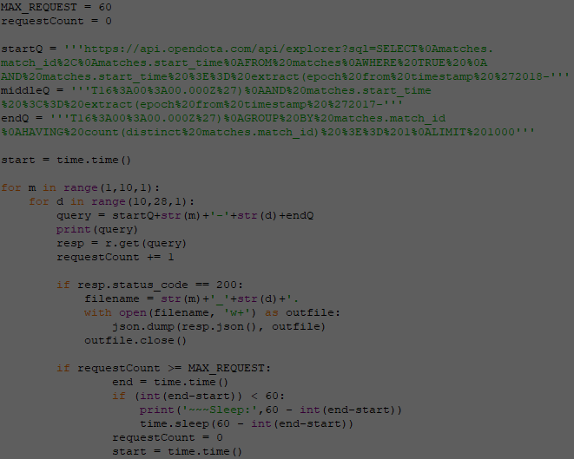
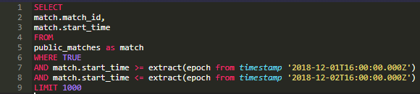
Data mining
Match INFO
Player INFO
opendota.api
dotabuff.com
getMatchesList.py
matchID.json
(matchInfo list)
getPlayersID
fromMatch.py
getPlayersInfo.py
(web scraper)
matchesList.json
(matchesID list)
getMatchInfo.py
players.id
(playersID list)
playerID.json
(playerInfo list)
Notes:
The SQL query looks like this. We request matchID and matchTime. We need matchTime to ensure that the response from server correct.
---
SQL запрос выглядит так. Мы запрашиваем matchID and время в которое этот матч был проведен чтобы убедится что ответ на запрос корректный.

Slide 11
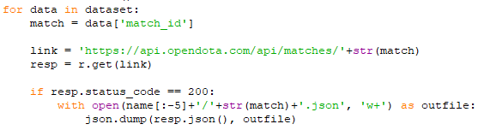
Data mining
Match INFO
Player INFO
opendota.api
dotabuff.com
getMatchesList.py
matchID.json
(matchInfo list)
getPlayersID
fromMatch.py
getPlayersInfo.py
(web scraper)
matchesList.json
(matchesID list)
getMatchInfo.py
players.id
(playersID list)
playerID.json
(playerInfo list)
Notes:
Using matchID we send the the request opendota.api to get information about a particular match and if the response from the server without errors and write response as a json file with the name of the matchID
---
Используя matchID мы отправляем реквест opendota.api чтобы получить информацию о конкретном матче и если ответ от сервера без ошибок записываем ответ в файл с именем матча

Slide 12
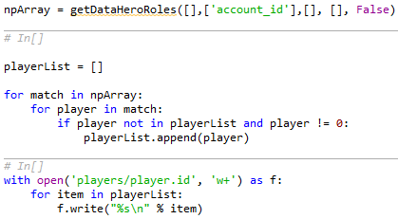
Data mining
Match INFO
Player INFO
opendota.api
matchID.json
(matchInfo list)
dotabuff.com
getMatchesList.py
getPlayersID
fromMatch.py
getPlayersInfo.py
(web scraper)
getMatchInfo.py
matchesList.json
(matchesID list)
players.id
(playersID list)
playerID.json
(playerInfo list)
Notes:
Run through all the files with matches and pull out all playerID and write in the player.id file
---
Пробегаем по всем файлам с матчами и вытаскиваем все playerID и записываем в отдельный файл.

Slide 13
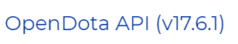
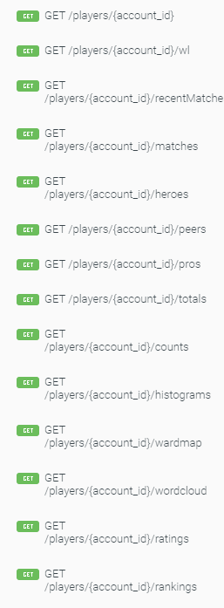
?
Notes:
OpenDota.api provides a lot of information, but the information about players is rather scarce, you can just believe me, and what to do? Of course, write our scraper, but if you send requests directly to the site opendota.com it will return garbage.
---
OpenDota.api предоставляет множество информации но информация по игрокам довольно скудная, можете просто поверить мне, и что же делать? конечно же писать свой scraper, но если отправлять реквесты непосредственно на сайт opendota.com он будет возвращать мусор

Slide 14
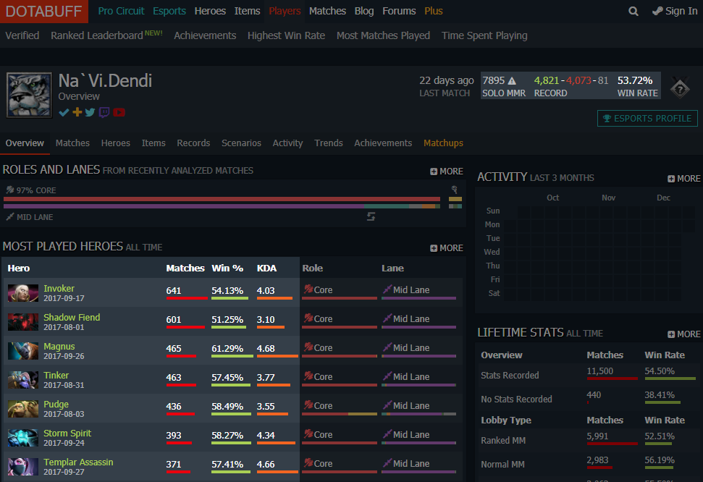
Wins 4821
Losses 4073
WinRate 53.72
SoloMMR 7895
List of heros
{
Invoker
Matches 641
Win 54.13
KDA 4.03
}
Notes:
Was found another site with relevant information about players, but without external api. We see that all the information we need is here. Wins, losses, winrate, soloMMR, and the list with the heros that this player played, the number of matches on each hero, % wins and KDA(kill death)
---
Был найден другой сайт с релевантной информацией по игрокам но без внешнего api. мы видим что вся необходимая нам информация тут присутствует. Wins, losses, winrate, soloMMR, и лист с героями которыми этот player играл, количество матчей на каждом герое, % wins and KDA (???)

Slide 15
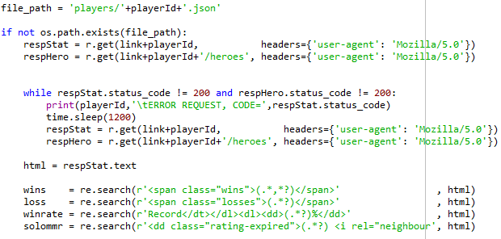
Data mining
Match INFO
Player INFO
opendota.api
dotabuff.com
getMatchesList.py
matchID.json
(matchInfo list)
getPlayersID
fromMatch.py
getPlayersInfo.py
(web scraper)
matchesList.json
(matchesID list)
getMatchInfo.py
players.id
(playersID list)
playerID.json
(playerInfo list)
Notes:
The web scraper was written to request a page with player information and a page with info about his heros. As you see, regular expression were used to search for the useful information on the page.
---
Был написан web scraper для запроса страницы с информацией игрока и страницы с инф о его героях. Так же как вы можете видеть, были использованы регулярные выражения для поиска необходимой информации на странице.

Slide 16
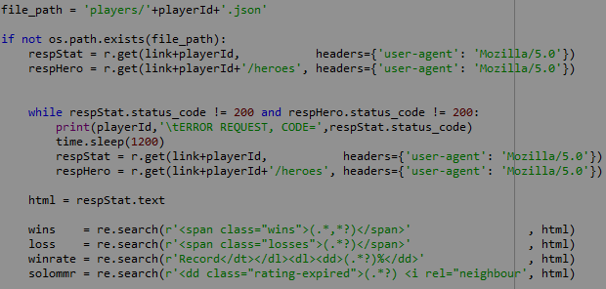
Data mining
Match INFO
Player INFO
opendota.api
dotabuff.com
getMatchesList.py
matchID.json
(matchInfo list)
getPlayersID
fromMatch.py
getPlayersInfo.py
(web scraper)
matchesList.json
(matchesID list)
getMatchInfo.py
players.id
(playersID list)
playerID.json
(playerInfo list)
Notes:
But there was a problem, because of which it was necessary to reduce the size of our used dataset. The site allowed us to send only 250 requests per hour, which with the number of 20000 players planned in a beginning would initially take 80 hours to get all of them. So the number of players has been reduced to 8375
---
Но возникла проблема из за которой пришлось уменьшить размер используемого датасета. Сайт позволял отправлять только 250 запросов в час, а это значит что мы могли получать информацию о 250 игроках в час, что при количестве 20000 игроков планируемых изначально заняло бы 80 часов непрерывной работы. поэтому количество игроков было уменьшено до 8375

Slide 17
3. Data Modeling
0745087 Robin Mike Wiethüchter

Slide 18
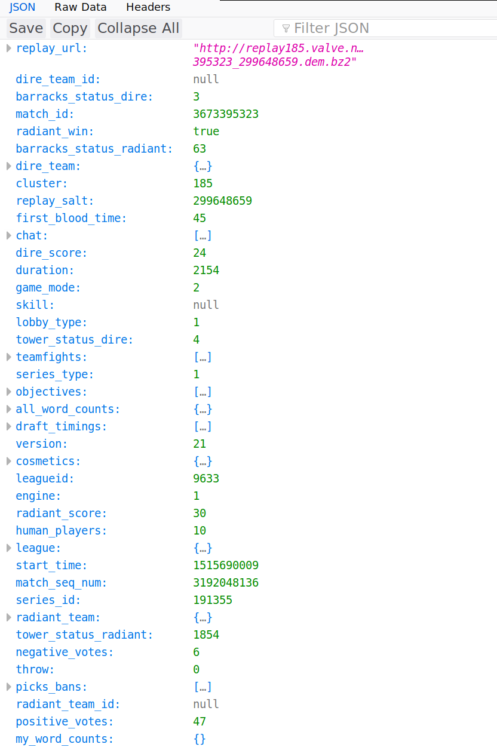
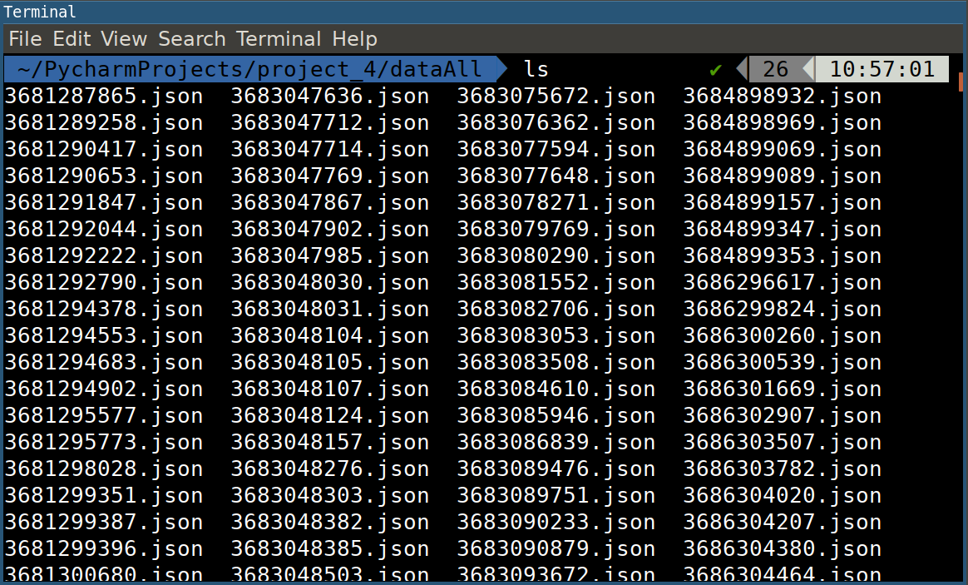
Data Modeling
Match
file

Slide 19
Data Modeling
Match
file

Slide 20
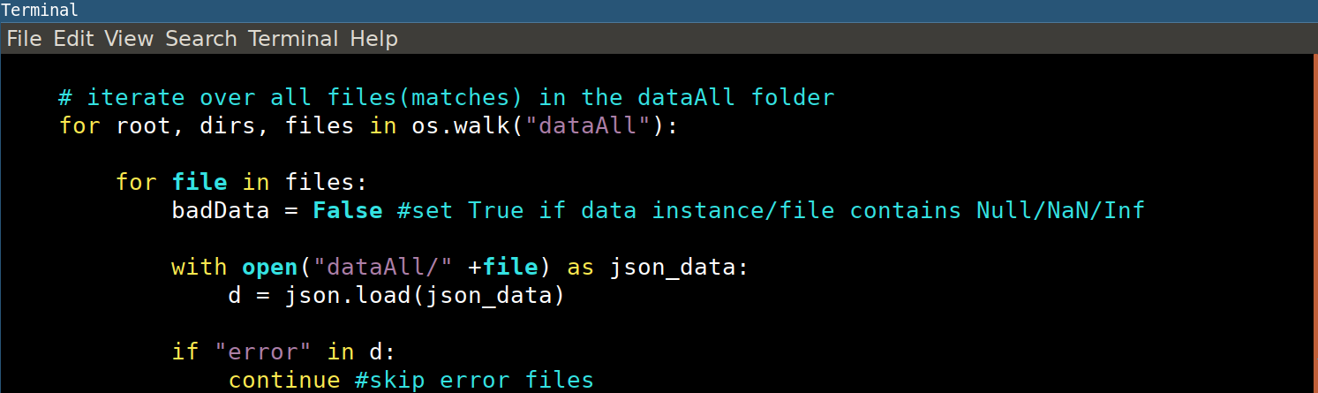
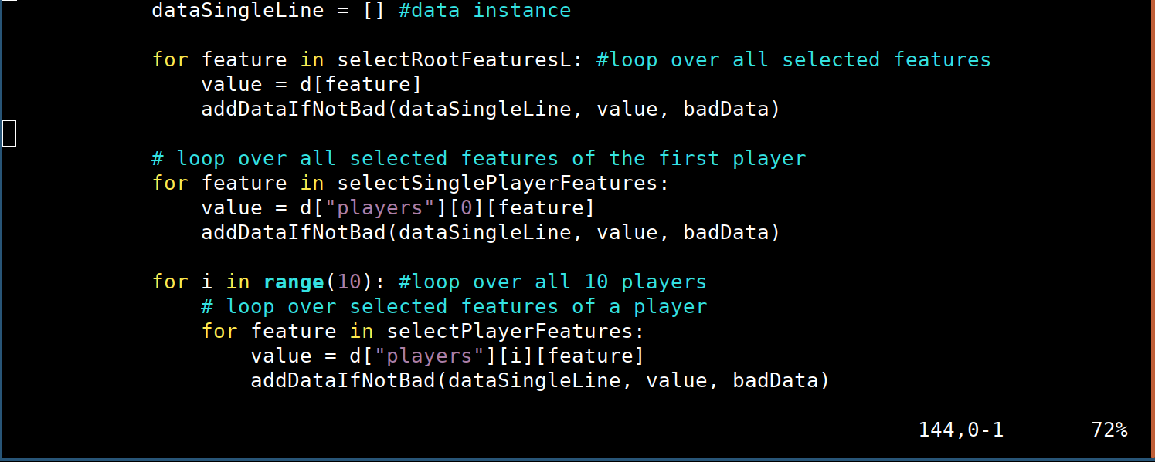
Data Modeling
Match
file

Slide 21
Data Modeling
Match
file

Slide 22
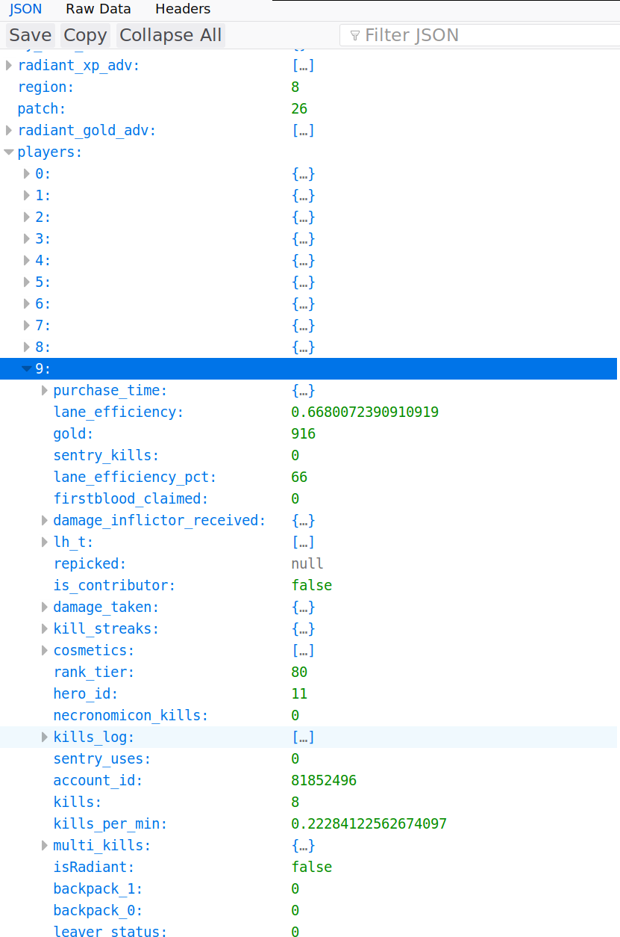
Data Modeling
Match
file

Slide 23
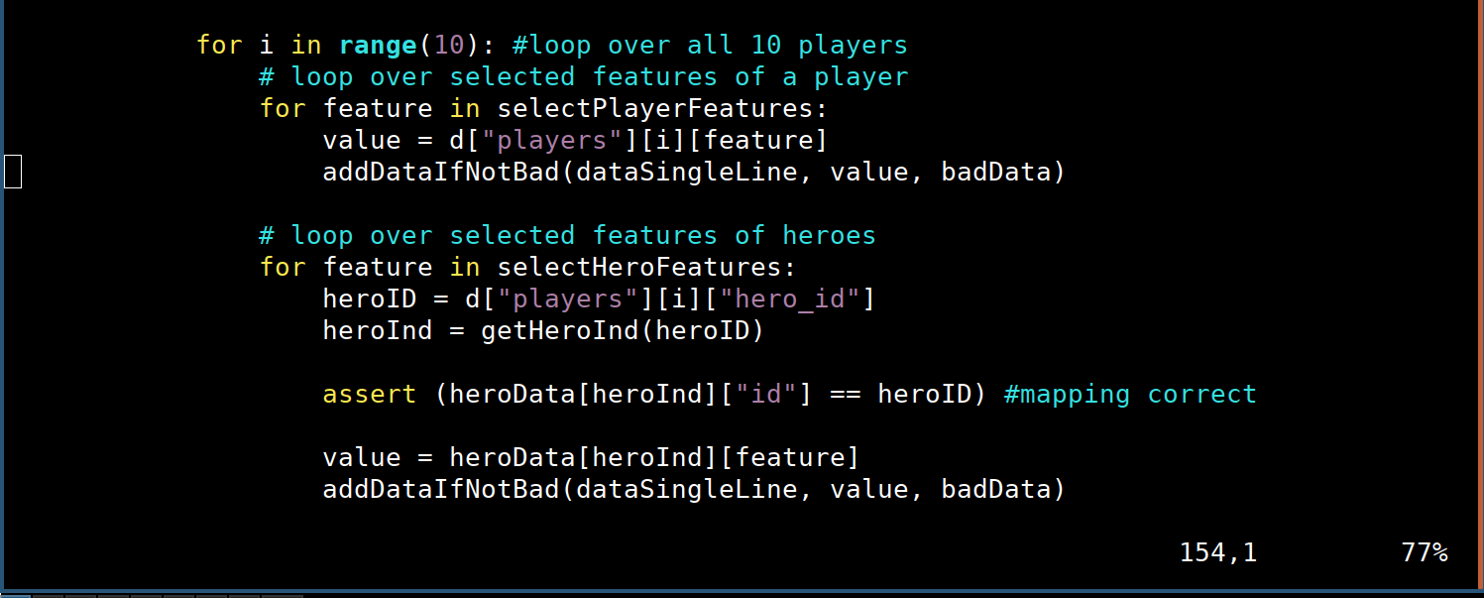
Data Modeling
Match
file

Slide 24
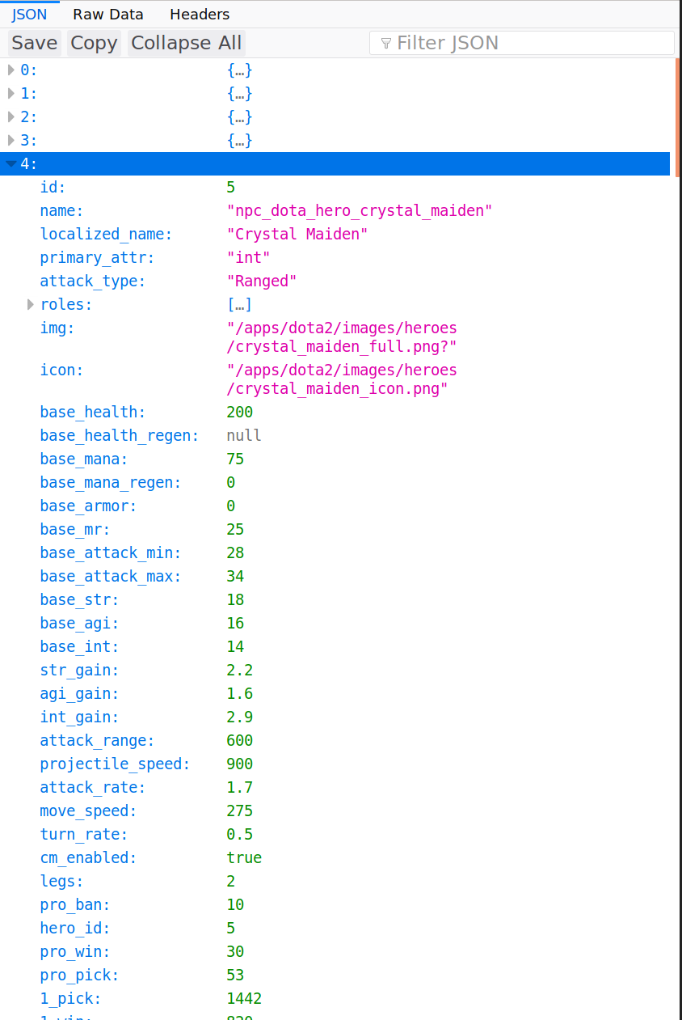
Data Modeling
Heroes
file

Slide 25
Data Modeling
getData -
output example
Match Features | Player Features | Player Hero Features |  |  |  |  |  |  |  |  | Match Feature - Target
[“duration”] | [“hero_id”] | [base health”, | “attack_rate”] |  |  |  |  |  |  |  | [“radiant_win”]
 | 0 |  |  | 1 |  |  | ... | 9
2154 | 27 | 200 | 1.9 | 72 | 200 | 1.7 | ... | 11 | 200 | 1.4 | 1

Slide 26
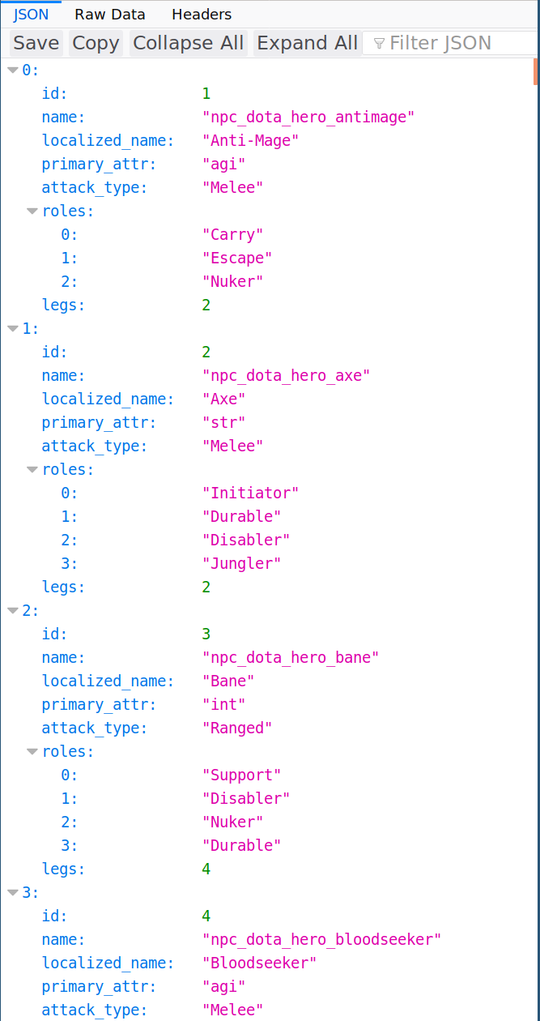
Data Modeling
getData -
Role output example
radient_roles = {"Carry": 0, "Initiator": 1, "Nuker": 2, "Disabler": 3, "Durable": 4, "Escape": 5, "Support": 6, "Pusher": 7, "Jungler": 8}
... | Role count |  |  |  |  |  | Match Feature - Target
 | Team 1 |  |  | Team 2 |  |  | [“radiant_win”]
 | “Carry” (0) | ... | “Jungler” (8) | “Carry” (0) | ... | “Jungler” (8) | 1
 | 0 | ... | 2 | 3 | ... | 1 | 1

Slide 27
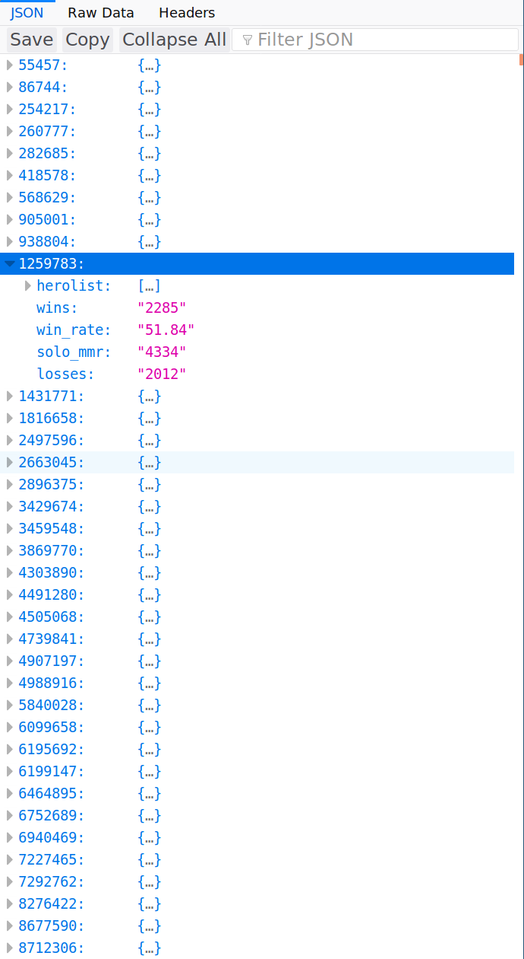
Data Modeling

Slide 28
Data Modeling
getData -
stats output example
... | Player Stats |  |  |  |  |  | Match Feature - Target
 | [“wins”, | “losses”, | “solo_mmr”] |  |  |  | [“radiant_win”]
 | Team 1 average |  |  | Team 2 average
 | 2285.7 | 2012.8 | 4334.0 | 1990.5 | 2101.0 | 3806.0 | 1

Slide 29
4. Machine Learning
0745102 Mikael Paavola

Slide 30
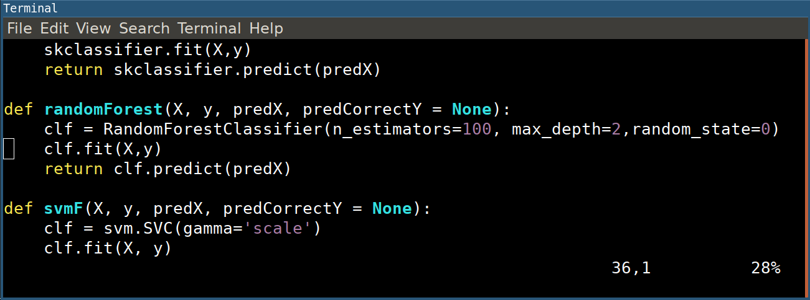
Machine Learning
scikit-learn
Notes:
Used scikit learn library to implement various learning algorithms such as decision tree, random forest, neuralnets , SVM and linear regression.

Slide 31
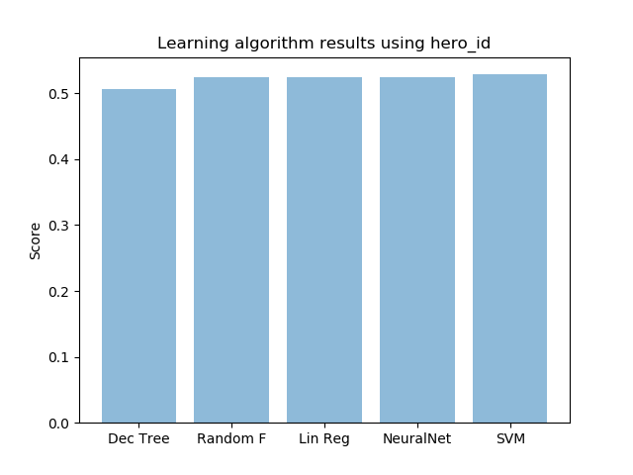
Machine Learning
Only Heroes
test size: 30%, 1538 training size: 70%, 3586
Notes:
Around 50% for all
Wanted to predict match outcome using information available before match. Heroes are an obvious feature, but there are too many combinations. Using this feature resulted in a bad score.

Slide 32
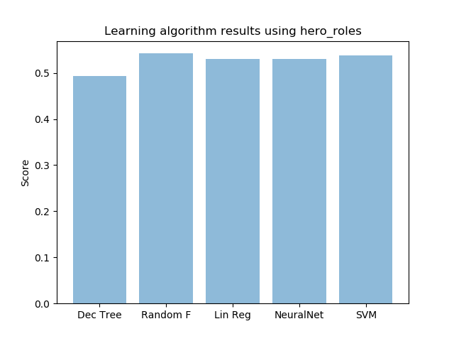
Machine Learning
Only Hero roles
test size: 70%, 3587 training size: 30%, 1537
Notes:
Tried to reduce heroes to their roles, result still around 50%
We tried to reduce the hero feature to their respective roles, so as to reduce the number of combinations. Then we could see if there was a trend in the hero roles matchup and who won. This too gave a bad score however.

Slide 33
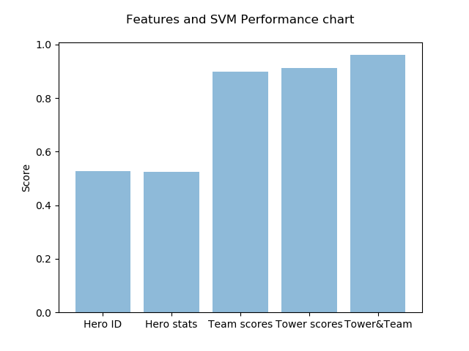
Machine Learning
Including after game data
test size: 70%, 3587 training size: 30%, 1537
Notes:
Tried to predict result of match using data only available after match. This gave a huge difference. Both killscore and tower_scores got the predictions up to 90%, but including both got us up to 96%
Hero id: 0.5286085825747724
Hero data: 0.524390243902439
Team scores: 0.89908001115138
tower_ scores: 0.911625313632562
Team and tower: 0.9609701700585448

Slide 34
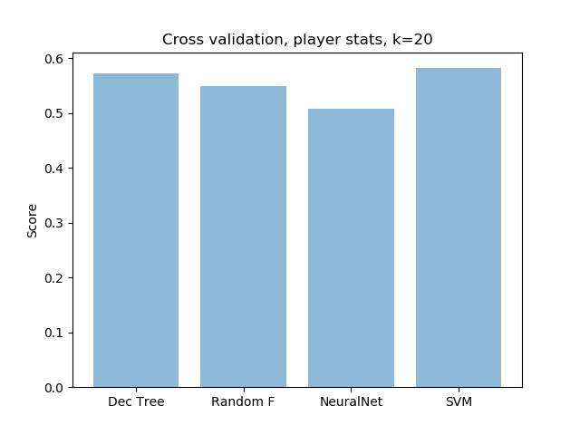
Machine Learning
Using player data
Solo mmr
Wins
Winrate
Losses
Notes:
We still wanted to try to predict who wins before a match has begun. Using player data gathered through a crawler we made we acquired these player features.
Using only these player features and the roles of the heroes they played, our cross validation gave us a 55% accuracy on predictions, showing we have found a small trend in who
Is likely to win the match.

Slide 35
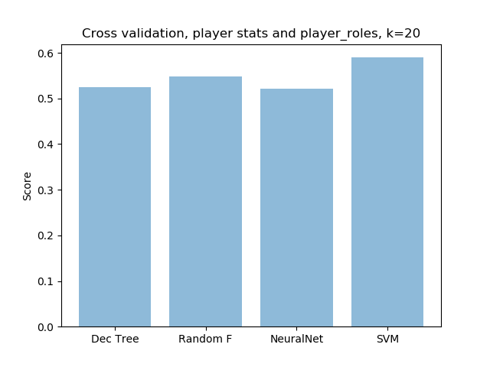
Machine Learning
Using player stats and roles
Up to 59% using SVM
Notes:
data instances 5124 bad data 4068
The data used in these checks came from incomplete datasets, as a lot of player data was missing. We would take data from teams where atleast more than 2 from each team was available, we would take the average of those present as use that as the player scores.0.58

Slide 36
Conclusion
OpenDota limitations
Pre-match prediction is hard
Player Stats achieve best result -> 59
After-match prediction is much easier -> ~90%
Complex Data -> SVM, simple Data -> Decision Tree

Slide 37
Tasks
0745062 Aida Gasanova
Report, Presentation
0745061 Ivan Kakhaev
Data Mining, Preprocessing
0745087 Robin Mike Wiethüchter
Preprocessing, Data Modeling, Machine Learning
0745102 Mikael Paavola
Machine Learning, Analysis

